Slide 1
Electronics 101 with Raspberry Pi – Rotation 1
David Crook
@Data4Bots
Questions: dacrook@Microsoft.com

Slide 2
Agenda
The ‘me’ slide
Things to know
Goals
Content
Summary
Continuous Q&A

Slide 3

David Crook
Microsoft Developer Evangelist
Focused on Machine Learning and Embedded Systems
Enjoys challenges
Likes Fishing + Brazilian Jiu Jitsu
Typically not together
dacrook@Microsoft.com
(980)228-6278
@Data4Bots
www.indiedevspot.com

Slide 4
Stuff you should Know About
Additional Resources
Channel9: http://channel9.msdn.com
Hackster: https://www.hackster.io
Stack Overflow: http://electronics.stackexchange.com/
BizSpark
Free Azure
Free Tools Network Partner Give to your startups for free
Microsoft Innovation Center
Hack Tuesdays: Mentoring every Tuesday 11am – 4pm
Free Co-Working for Startups: dacrook@Microsoft.com to apply
Free Training: See schedule here: http://indiedevspot.com/events/

Slide 5
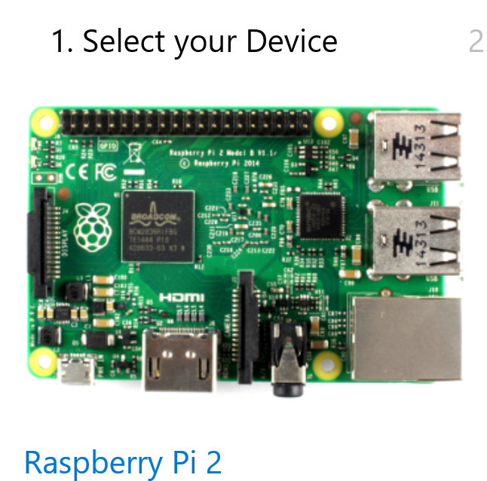
Future Reference Getting Started
http://ms-iot.github.io/content/en-US/GetStarted.htm

Slide 6
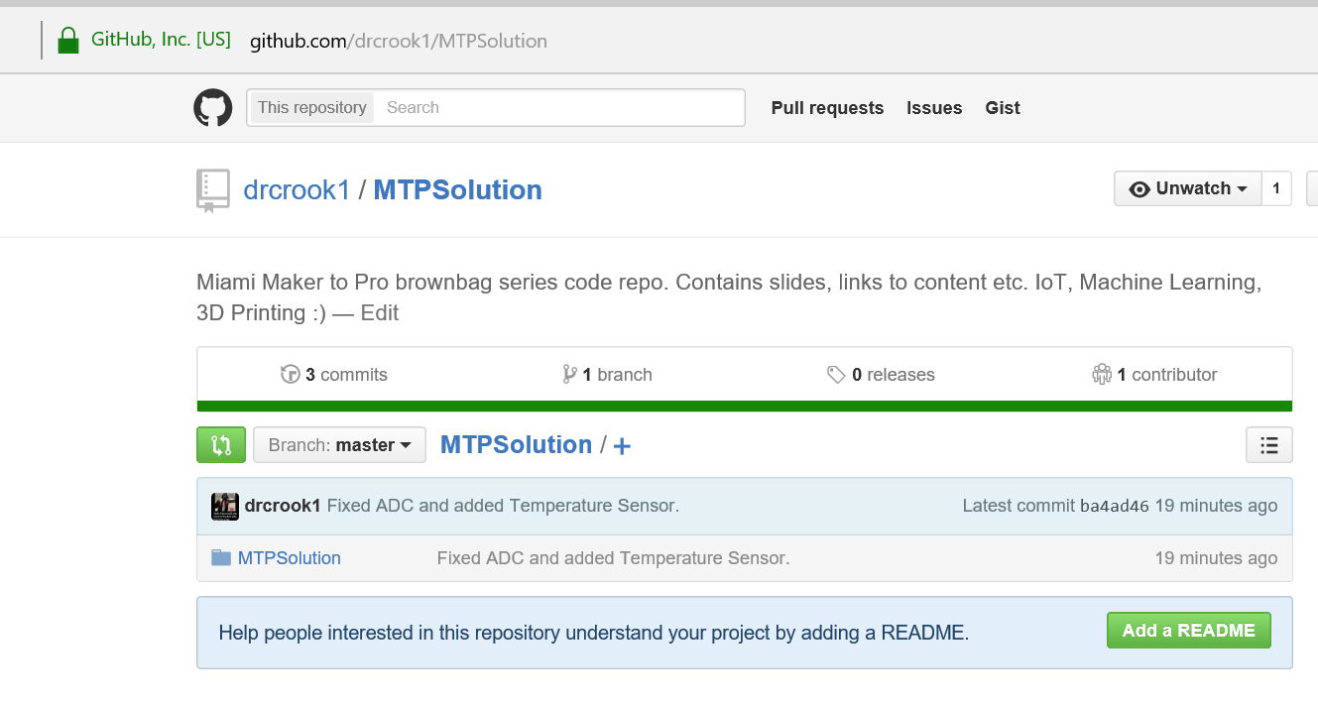
Get the Codes
https://github.com/drcrook1/MTPSolution

Slide 7
Goals of Presentation
Understand Raspberry SPI Interface
Understand ADC and purpose
Collect Data from Light, Temperature and Pressure
Debug to verify values.

Slide 8
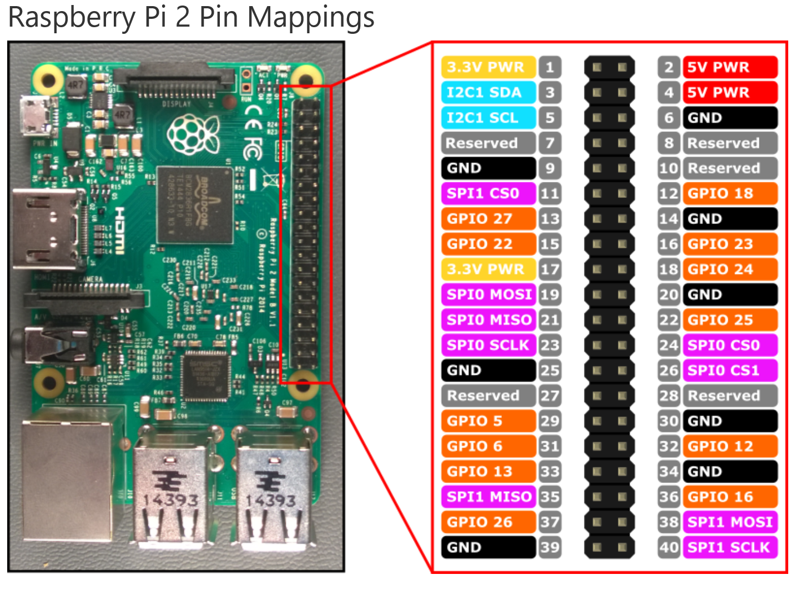
Will not concern
ourselves with:
I2C
Focus just on
Power
Ground
Gpio
SPI
Physical Pin
vs
Logical Pin

Slide 9
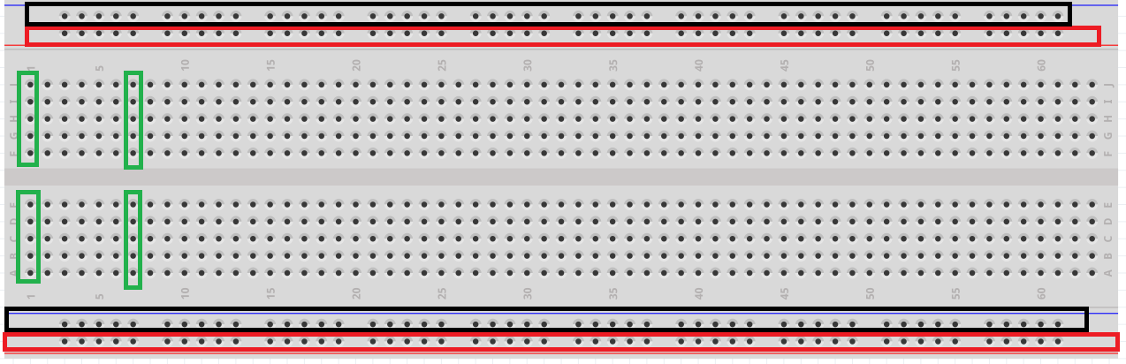
How a Breadboard works

Slide 10
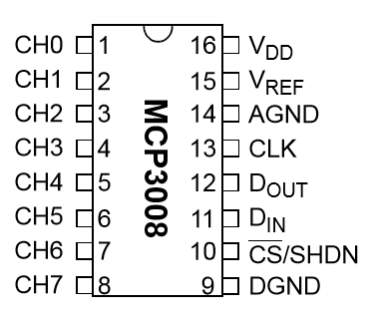
Understand ADC – MCP3008
Data Sheet: http://ww1.microchip.com/downloads/en/DeviceDoc/21295d.pdf
8 Channel, 10 Bit, Duplex Communication
8 Analog Inputs
10 bit value resolution (0-1023 value range)
Send/Receive same operation and byte size.
Explain Pins
Vdd/Vref – power and ref voltage
Clk – data transfer speed
CS – Channel Select
Dout/Din – data lines
Agnd/Dgnd - grounds

Slide 11
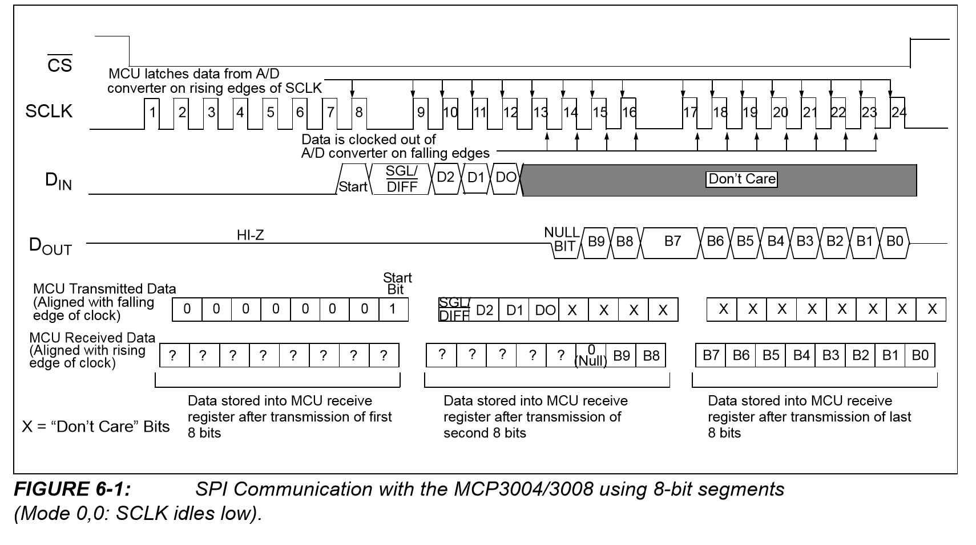
Duplex Data with 8 bit (1 byte) Segments
Notes:
We are concerned with 8 bit segments as most Microcontrollers (Pi included) communicate purely on 8bit segments, while the ADC is 10 bit.
10 bit resolution as in the MCP3008 means to initiate a data receive sequence you need to transfer 2 bytes, last bit of the first byte says next coming byte is the channel mode and channel. The next two bytes, the first bit is null, the next 10 are data and the rest are null.

Slide 12
Code – Read ADC Value from Channel x
public int ReadValue(int channelNumber)
{
if ((channelNumber < 0) || (channelNumber > ChannelCount)) throw new ArgumentOutOfRangeException("channelNumber");
EnsureInitializedAsync().Wait();
byte[] writeBuffer = new byte[3] { 0x00, 0x00, 0x00 };
byte[] readBuffer = new byte[3];
UInt16 command = 0x0;
if (ChannelMode == ProviderAdcChannelMode.Differential)
{
int shiftLeftNum = 8; // 15 - 7
int channelShifter = 13;
command = (UInt16)((0x01 << shiftLeftNum) |((Int16)channelNumber << channelShifter));
}
else
{
int shiftLeftNum = 8; // 15 - 7
int channelShifter = 13;
command = (UInt16)((0x03 << shiftLeftNum) | ( (Int16)channelNumber << channelShifter ) );
}
var commandBytes = BitConverter.GetBytes(command);
writeBuffer[0] = commandBytes[1];
writeBuffer[1] = commandBytes[0];
spiDevice.TransferFullDuplex(writeBuffer, readBuffer);
int result = readBuffer[1] & 0x03;
result <<= 8;
result += readBuffer[2];
return (int)result;
}
Notes:
Don’t worry, this is already written…
Write Buffer and Read Buffer are same due to communication in Duplex, every bit written is also outputted to both devices.
Leading bits is established based on resolution of ADC such that the beginning of the data bits lines up with actual bytes.
In this instance:
Sent Bits
0000 0001 – byte 1 – this one is the start listening command
1111 0000 – byte 2 - this is single mode (first bit) and 7th channel, 7 in bits is 111, for channel 0, 000 would follow the 1, for channel 1 – 001
Second half of byte is ignored
0000 0000 – byte 3 – ignored by adc
0000 0000 – byte 4 - ignored by adc
Received Bits
0000 0001 – byte 1 duplex, input is output
1111 0000 – byte 2 duplex, input is output
? ??? ??dd – byte 3 bit 1 is null, next 5 are noise signals, last 2 are data
dddd dddd – byte 4 is all data
Therefor, we shift left by 22 bits to remove the garbage, and shift back by 22 bits to ensure correct bit significance. This makes sense as it is a 10 bit resolution adc, and we have 32 bits in 4 bytes.

Slide 13
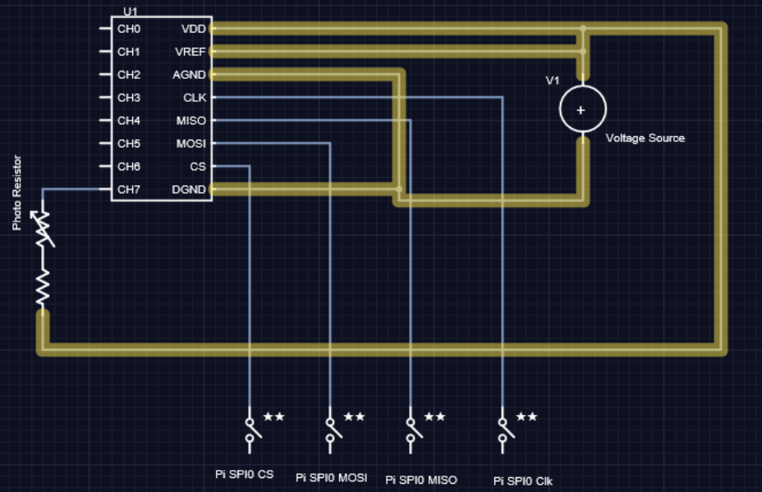
Schematic

Slide 14
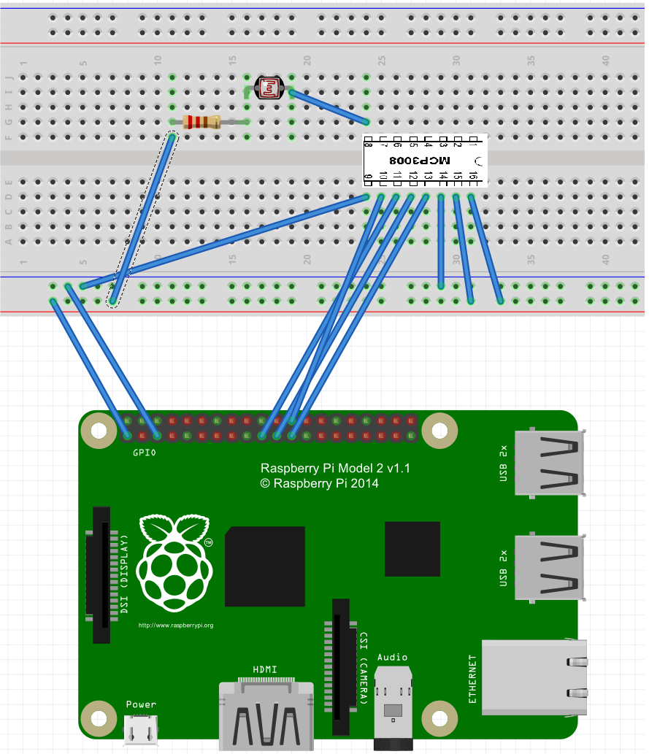
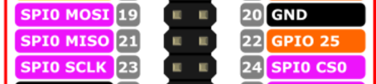
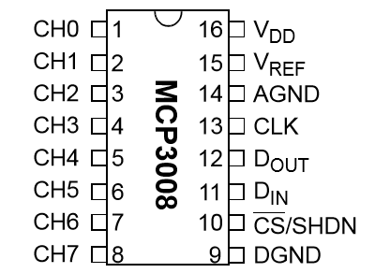
Wiring Diagram
Make sure correct before powering on
Notes:
Mosi – Master Out, Slave in matches to MCP3008 Data In
Miso – Master In, Slave out matches to MCP3008 Data Out
SCLK – Matches to MCP CLK
CS0 – Matches to MCP CS

Slide 15
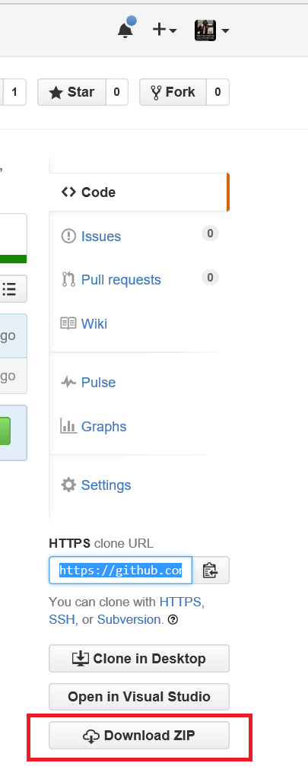
Connect Pis and Download Code
Ethernet Cable to Adapter to Computer USB
Power On Pi
Download the Zip
https://github.com/drcrook1/MTPSolution
Then extract it

Slide 16
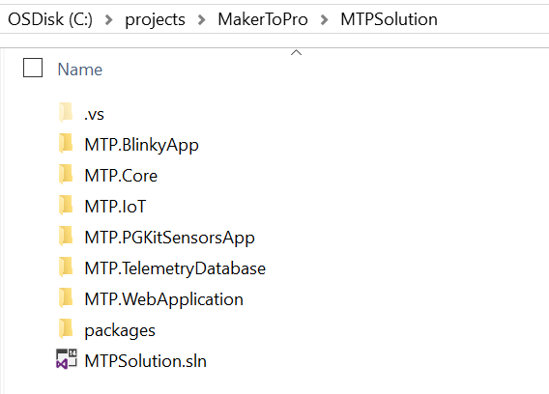
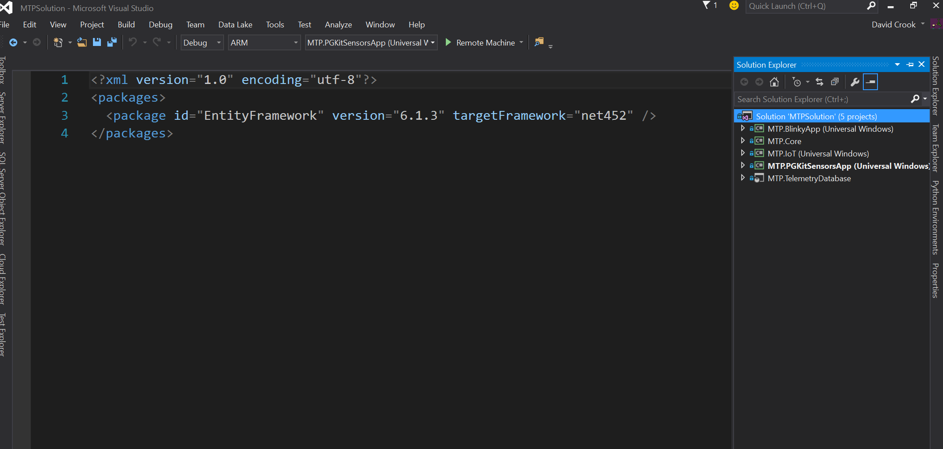
Open the Code
Open Visual Studio 2015 Community
Excellent programming tool.
Double Click .sln file
Opens in VS 2015

Slide 17
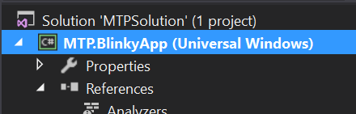
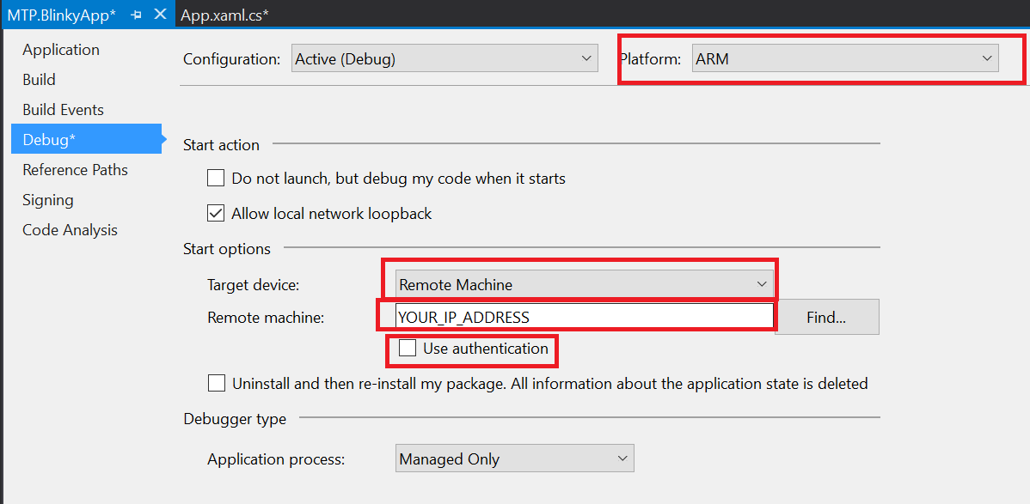
Set Build for your Device
Right Click Project
Properties (at the bottom)
ARM
Remote
Your IP
No Auth

Slide 18
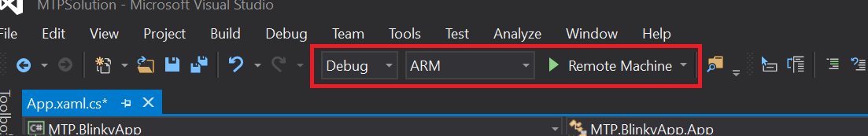
Deploy && Debug
Set to ARM
Click In Gray Area
Creates red breakpoint
Click Green Arrow
You can remove breakpoint and click green arrow to continue.

Slide 19
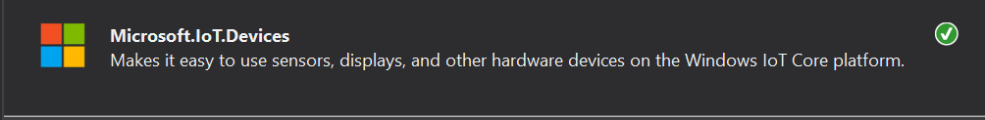
How it Works
Nuget Package
Extended through MTP.IoT Project
Project reference, added new ADC controller for MCP3008 which is in the kit
Use peripherals and management system provided by IoT.Devices

Slide 20
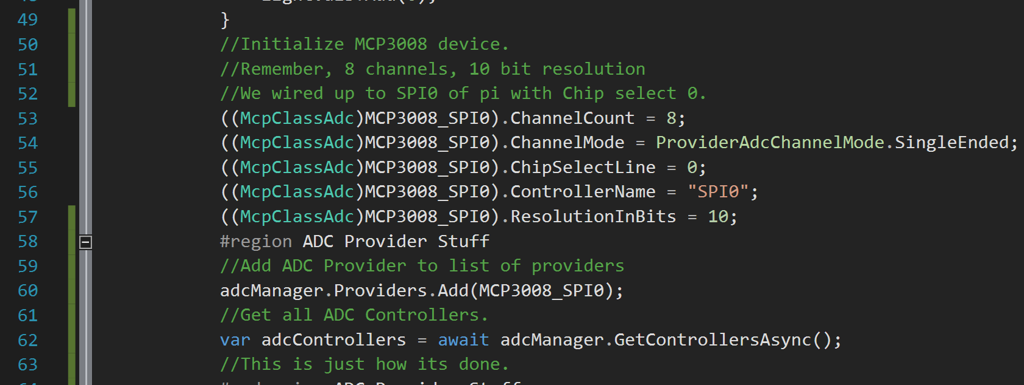
Code Walk Through
Notice extensive comments ☺

Slide 21
On your own

Slide 22
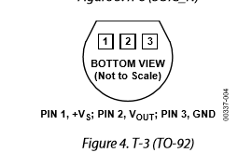
Add a Temperature Sensor
TMP36GZ http://www.analog.com/media/en/technical-documentation/data-sheets/TMP35_36_37.pdf
Double check correct power/ground
It will possibly catch fire if backwords.
Will definitely melt
Pin 1 = Power (+5V)
Pin 2 = Reading (analog out)
Pin 3 = Ground

Slide 23
Conversion
For every degree C, produces 10 mV
ADC produces measurements in: V
1 V = 100 mV – Therefor: Reading / 10 = Deg C
Convert to F = ( (9/5) * Cel ) + 32

Slide 24
What Next?

Slide 25

Baby Thermostat!
Is it too hot for baby?
Turn on the Fan!
Too cold for baby?
Turn off the Fan!

Slide 26
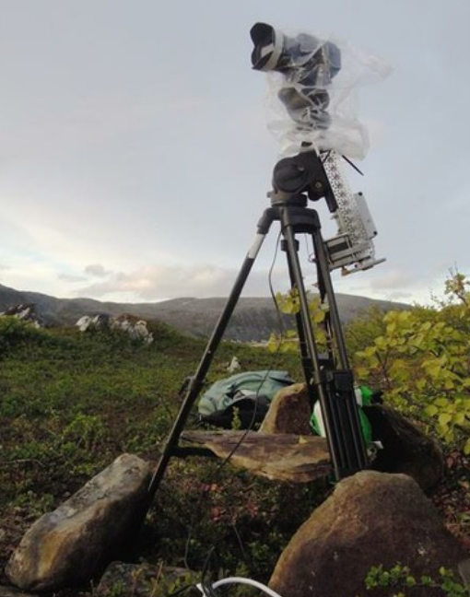
Light and Temp Tracking Camera
Use 2 of each sensor
Find a signature and follow it!

Slide 27
There is more!

Slide 28

Brown Bag Series
Electronics 101
3 Rotating Sessions
IoT 101
3 Rotating Sessions
Machine Learning 101
2 Rotating Sessions
3D Printing 101
Just 1 session!

Slide 29
Questions?

Slide 30
dacrook@Microsoft.com
(980)228-6278
@Data4Bots
www.indiedevspot.com

